Slide 1
Why Do We Speak English?

Slide 2
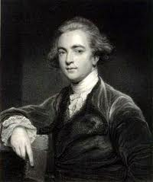
Sir William Jones
In the 1700’s, Sir William Jones noticed a remarkable similarity in words from ancient Sanskrit, Latin, & Greek.
Sanskrit for father: pitar
Latin for father: pater
Sanskrit for mother: matar
Latin for mother: mater
He theorized that all three languages came from one ancient or common source.
He was right!

Slide 3
Indo-European “Common Source”
We now know that the languages of about one-third of the human race come from this Indo-European “common source.”
English: brother
Dutch: broeder
German: bruder
Greek: phrater
Russian: brat
Irish: braither
Sanskrit: bhratar

Slide 4
The “Common Source” Spreads
Indo-Europeans lived north central Europe between 6000 BC to 4500 BC.
The horse & wheel caused them to migrate in all directions.
Those who ended up in Britain were known as Celts.

Slide 5
Early Britain
The Celts

Slide 6
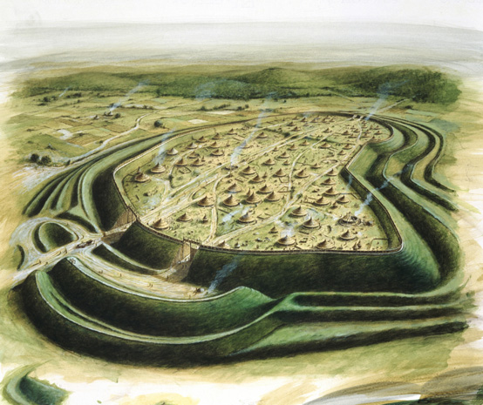
Celts were also known as Britons
The Britons were warriors, farmers, and skilled metal workers. They built villages and hill forts.

Slide 7
55 BC: The Romans Invade
Julius Caesar captured a Celtic hill-fort. When the Celts agreed to pay a tribute to Rome, Caesar left.
He didn’t think Britain was worth a long war, & he wanted to go home. This lasted for about 100 years.

Slide 8
43 AD: Romans Return
The Romans under Emperor Claudius returned for a final, successful invasion of Britain. This time they stayed 400 years.

Slide 9
Roman Contributions to Britain
Cities (Londinium…London)
Roads—nearly 5,000 miles of them
Government
Protection from invaders
Written scholarship
Eventually…Christianity

Slide 10
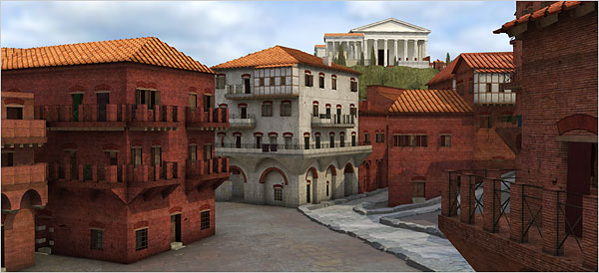
Celts vs. Romans

Slide 11
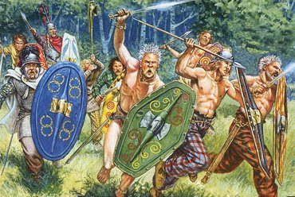
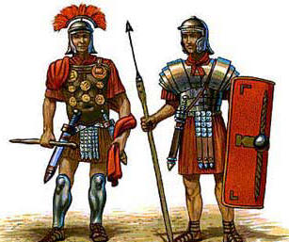
Celts vs. Romans

Slide 12
Roman Roads
Bits of Roman road can still be seen. Soldiers and carts used this cobbled road (at Blackstone Edge in Lancashire) to travel between Mamucium (Roman for Manchester) and Yorkshire.

Slide 13
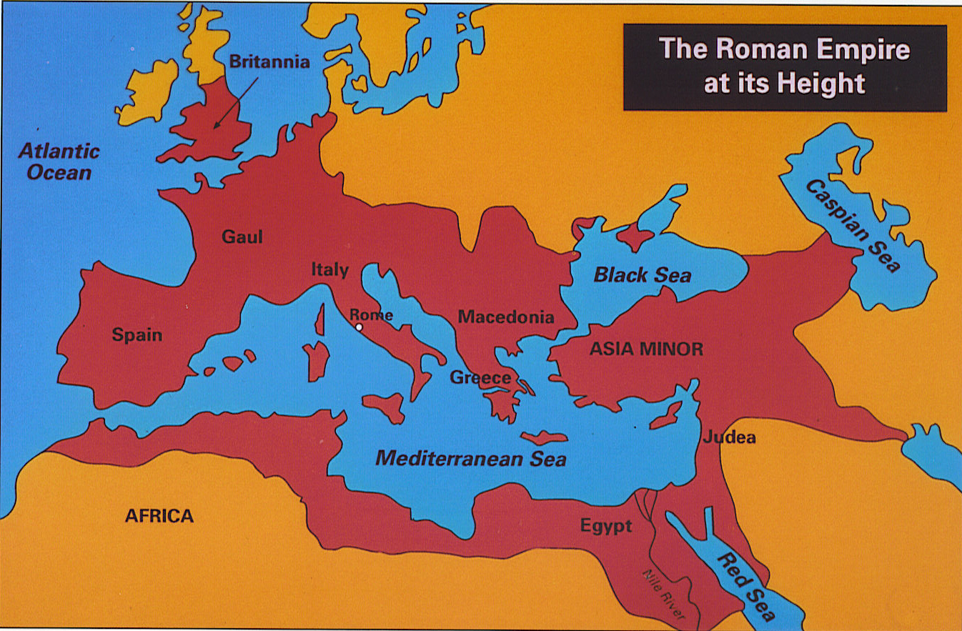

Slide 14
Hadrian’s Wall
In A.D. 122 the Emperor Hadrian ordered his soldiers to build a wall between Roman Britain and Scotland. You can still walk along parts of Hadrian's Wall today.
http://www.youtube.com/watch?v=9Dju30LGHp4

Slide 15
Why did the Romans leave?
In AD 410, the Roman legions left Britain because the Roman Empire was collapsing.
Their exodus left Britain without a central government or army, making it vulnerable to invasion.
And the invasions began!

Slide 16
Who Came Next?
Next to invade Britain were the Anglo-Saxons:
the Angles--Germany
the Saxons--Denmark
the Jutes--Holland

Slide 17
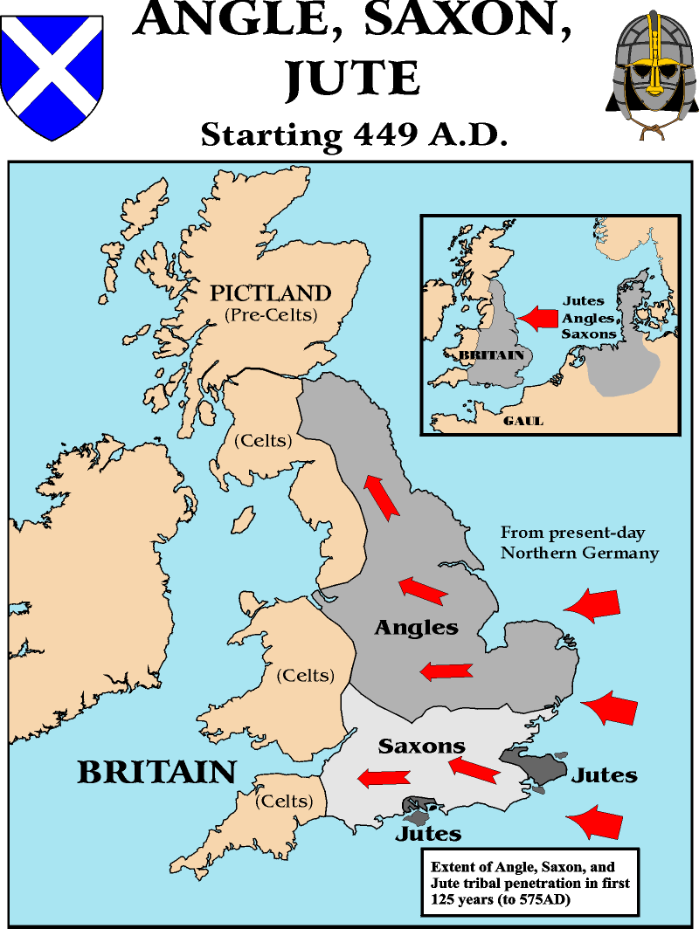

Slide 18
The Anglo-saxon Period
449-1066 A.D.

Slide 19
Anglo-Saxon Period: The Dark Ages
It was a time of bloody conflicts, ignorance, violence, and barbarism.
Literature reflects this difficult life.
Most stories & poems present heroic struggles in which only the strong survive.

Slide 20
The Anglo-Saxon Religion
offered no hope of an afterlife
valued earthly virtues of bravery, loyalty, generosity, and friendship
similar to what we call Norse mythology
Norse god
Anglo-Saxon god
Day of week
Odin
Woden
Wednesday
Thor
Thunor
Thursday
Notes:
BACKGROUND INFORMATION
Woden would help humans communicate with spirits and was associated especially with burial rites and ecstatic trances, important for both poetry and religious mysteries. Not surprisingly, this god of poetry and death played an important role in the lives of people who produced great poetry yet maintained a somber, brooding outlook on life.
Thunor was the god of thunder and lightning. His sign was the hammer and possibly also the twisted cross we call the swastika, which is found on so many Anglo-Saxon gravestones.

Slide 21
Anglo-Saxon House
This is what an Anglo-Saxon house was like. The people are modern but wearing 'Anglo-Saxon' clothes.

Slide 22
The Anglo-Saxon Chronicle
Part of the Anglo-Saxon Chronicle. It was written in Old English, so is quite hard to read today. It tells us a lot about Anglo-Saxon history.

Slide 23
Sutton Hoo Ship
The Sutton Hoo ship. This 1930s photo shows what archaeologists saw when they dug into the Suffolk burial mound.

Slide 24
Sutton Hoo Helmet
The Sutton Hoo helmet. This is a modern replica (copy) that shows what the helmet looked like when it was made.

Slide 25
Sutton Hoo Treasure
Shoulder clasps from Sutton Hoo. Made of gold, they were worn with a leather over-garment, and shaped to fit a man's shoulder. http://www.youtube.com/watch?v=np0pD1wW_Bo&list=TLx7IBKezvpIM

Slide 26
Anglo-Saxon Warriors…
Loved freedom
Admired strength, bravery, loyalty, fairness, & honesty
Were boastful, reckless, cruel, & bloodthirsty
Enjoyed conflict, swimming matches, horse races, banqueting, drinking mead, singing songs, and storytelling
Flyting: a conflict of wits between two warriors where each praises his own deeds and belittles the other’s.

Slide 27
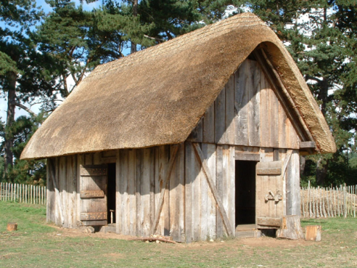
The Mead Hall
The mead hall or communal hall offered shelter and a place for council meetings. Mead was alcohol made from fermented honey.
It was also a place for storytellers or bards (scops) to orally share the stories of the Anglo-Saxons and their gods and heroes.
The Anglo-Saxons valued storytelling as equal to fighting, hunting, and farming.

Slide 28
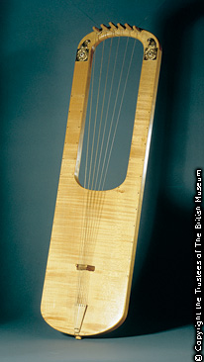
The Scops
strummed harp or lyre as they sang
sang of heroic deeds
were often warriors
Why were the scops important?
Anglo-Saxons did not believe in afterlife
warriors gained immortality through songs
Anglo-Saxon harp
Notes:
PRONUNCIATION GUIDE
scops (skahps)
BACKGROUND
The literature of the Anglo-Saxons was handed down orally by scops who sang in the lords’ mead halls, where warriors gathered to celebrate the events of the day. These scops, like the Greek poets before them, remembered their stories by using accentual meter and many stock phrases called kennings.
The word wyrd was used by the Anglo-Saxons to represent one’s fate in life.
The early Anglo-Saxons did not believe strongly in an afterlife; they believed that immortality, or lof—fame that survives death—could be earned through heroic action.
The Anglo-Saxon lyre (a type of harp) on the slide is a replica of a six-stringed instrument found at the Sutton Hoo archaeological site. It is a reconstruction based on fragments.

